Slide 1
PROJECT DATAMINING
Bookcrossing.com data in a Big-Data-Pipeline

Slide 2
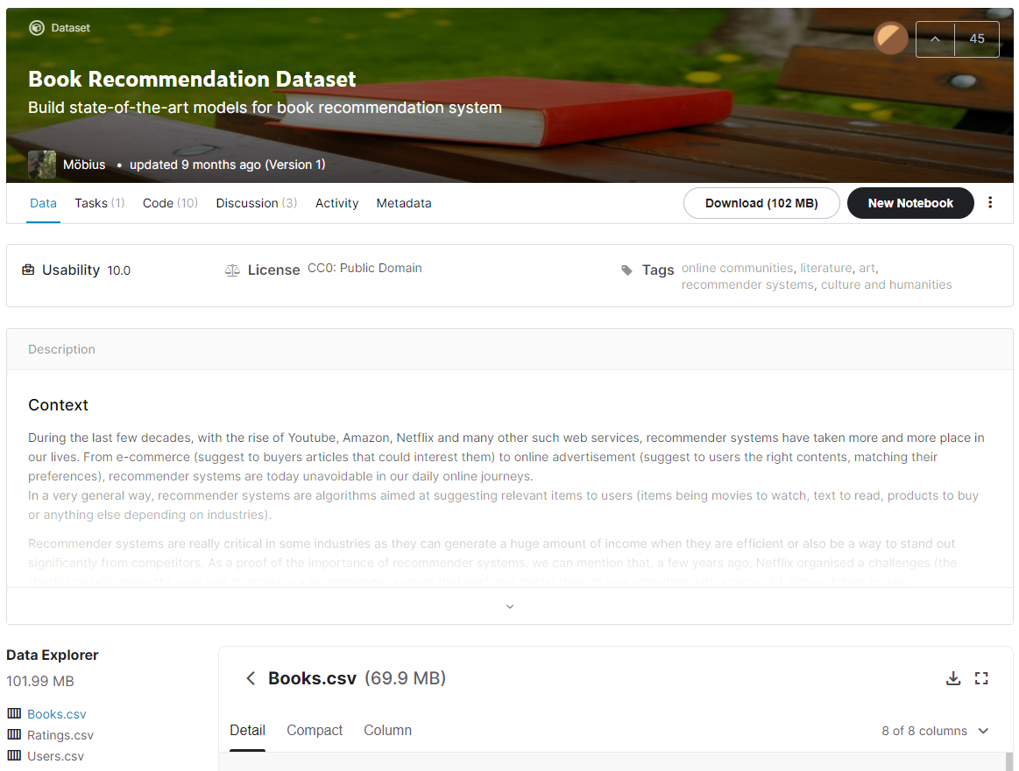
Dataset

Slide 3
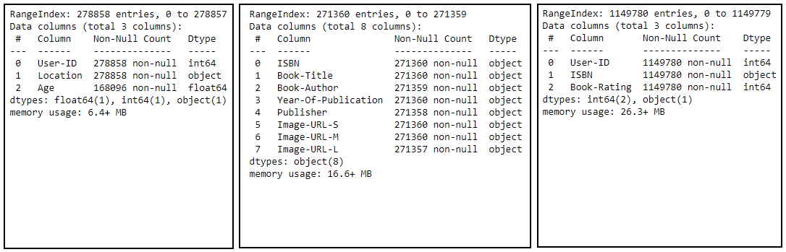

Slide 4


Slide 5
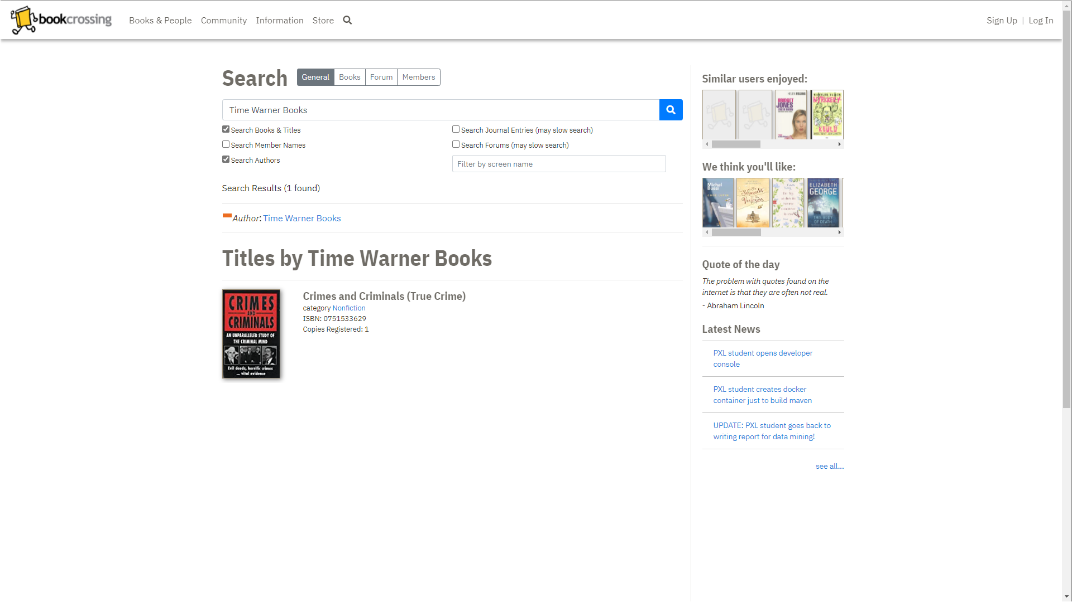

Slide 6
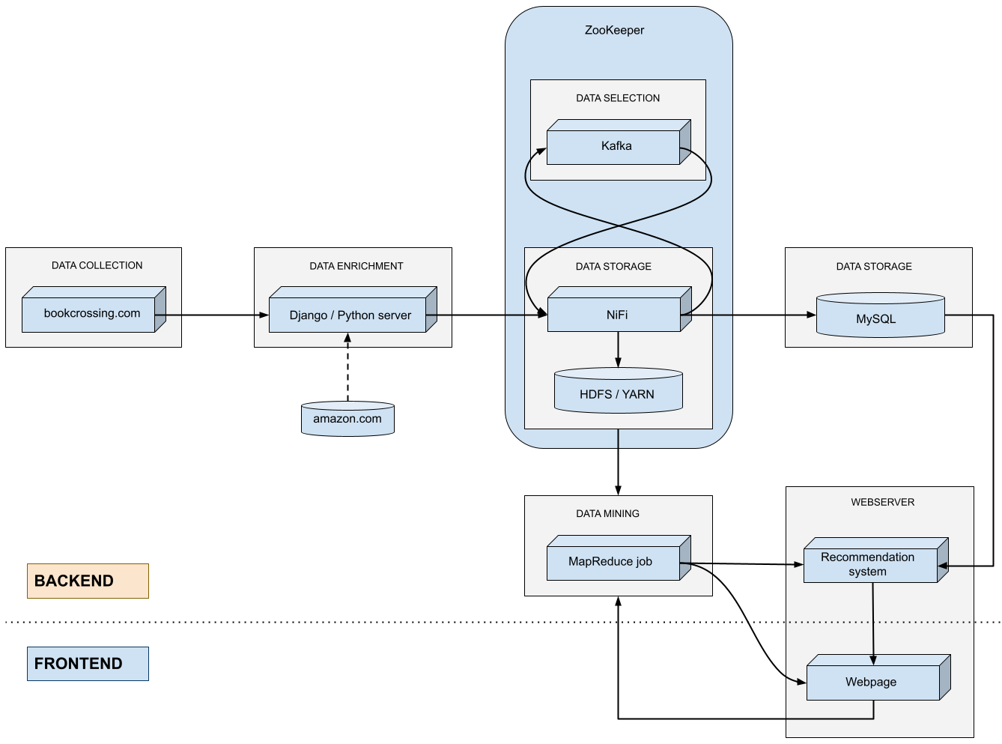
Big data pipeline

Slide 7
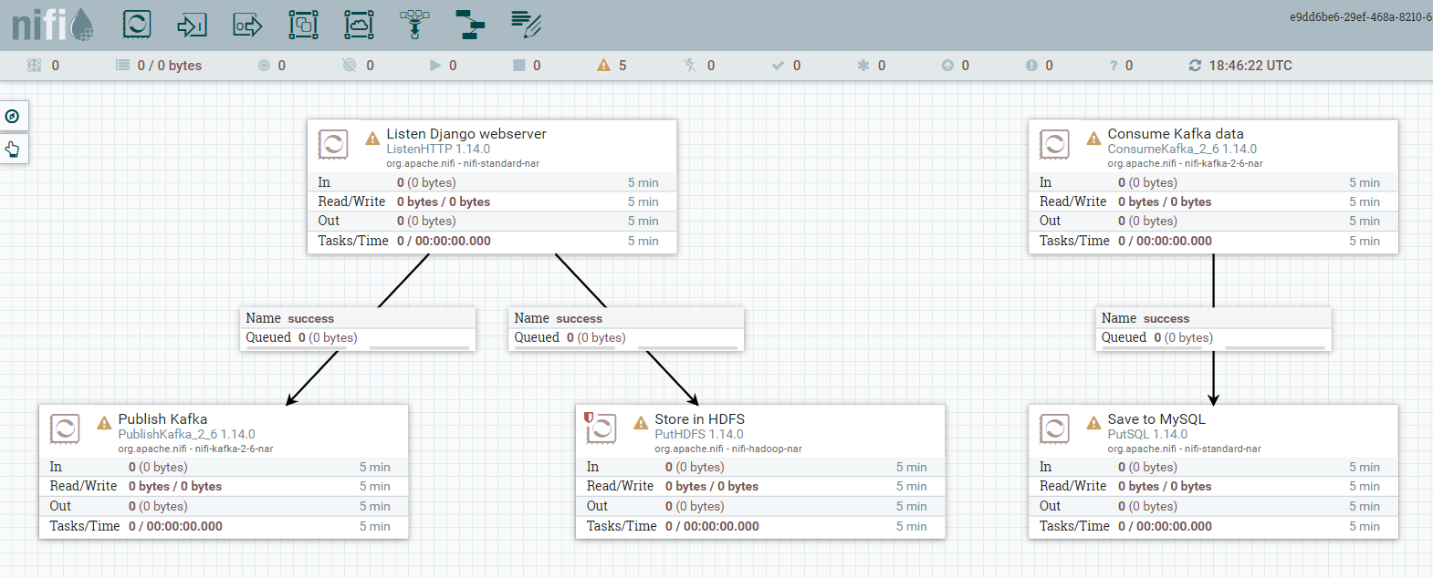

Slide 8
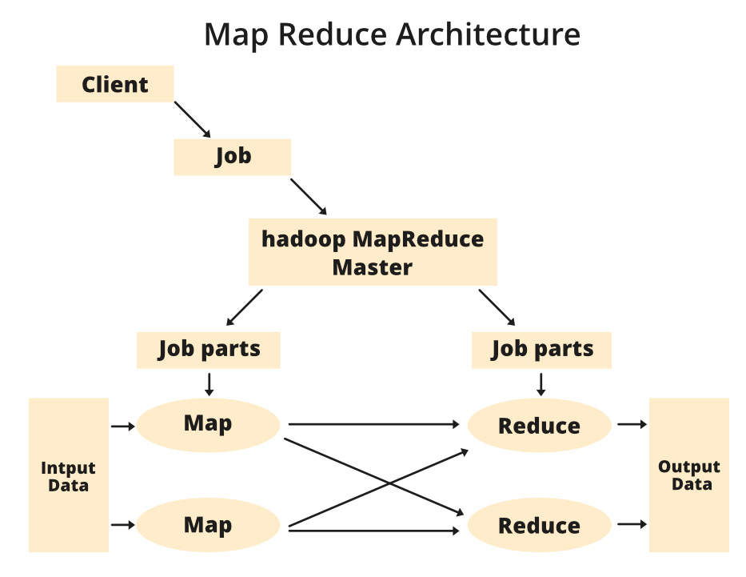
Map Reduce jobs

Slide 9
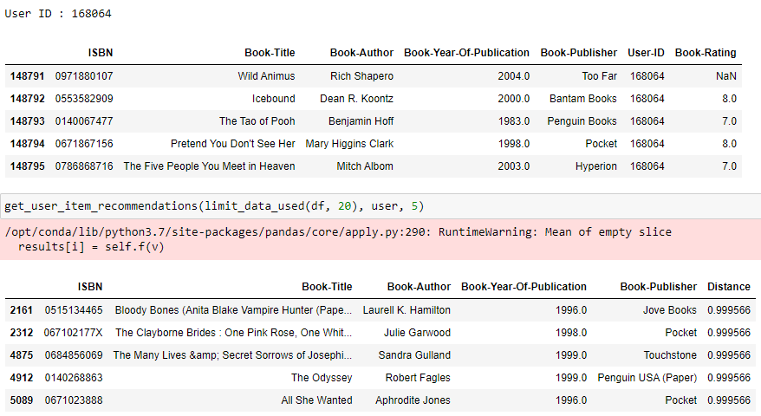

Slide 10
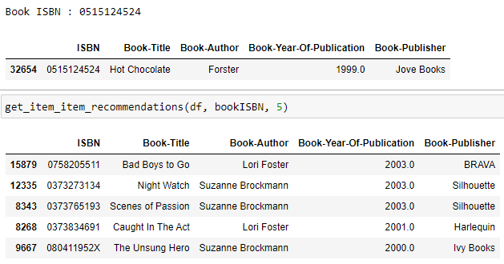

Slide 11


